Slide 1
« Comment is free but facts are sacred » ,
Charles Prestwich Scott ,Manchester Guardian, 1929

Slide 2
THE HEADING
WHAT IS THE ARTICLE ABOUT?
-WHO? (Who is Michel Barnier? Who is Boris Johnson?)
-WHAT?
-WHEN?
-WHERE?

Slide 3
THE SOURCE
IDENTIFY THE SOURCE:
-Name of the newspaper (does the newspaper only exist in an online-version?)
-Date of publication (was the article updated?)
-Name(s) of the journalist(s)?
CHECK THE SOURCE
What kind of newspaper is the Daily Mail? Is it a trustworthy source of information?

Slide 4
READ THE ARTICLE
Aides and advisers gathered in the Cabinet room for a series of video conferences with Mr Johnson, including the morning ‘Covid-19 war committee’, where the latest NHS data and international comparisons are shared.
Similar meetings of the war committee will take place tomorrow morning and throughout next week – assuming Mr Johnson continues to suffer only mild symptoms.
After the PM revealed his diagnosis, sparking a ‘stunned atmospshere’ among Westminster aides who learned the news only moments before it was made public, Health Secretary Matt Hancock tested positive for the virus on Friday, with Chief Medical Officer Chris Whitty then announcing he, too, had symptoms.
Yesterday Scotland Secretary Alister Jack became the third Cabinet member to start self-isolating after developing a mild temperature and a cough.
This newspaper understands that Mr Johnson is refusing to countenance the idea of stepping aside to let Foreign Secretary Dominic Raab take temporary charge on the grounds that he feels well enough to work and has no underlying health conditions.
But sources say that although Mr Johnson is trying to maintain his ‘usual sunny self’, he is blighted by a dry cough.
He is continuing to fulfil his duties, speaking on Friday evening to Donald Trump. It is understood the Prime Minister asked for help acquiring more ventilators, while Mr Trump commiserated with Mr Johnson during ‘one-on-one time’, with no aides listening.
The last Cabinet meeting to take place in person was March 17, meaning attendees could have contracted the virus without yet showing symptoms.
Last Tuesday’s meeting took place via video conference with only Mr Johnson, Mr Hancock, Professor Whitty and Cabinet Secretary Sir Mark Sedwill – the country’s most senior civil servant – attending in person.
Until last week – in violation of the Government’s own social distancing rules – the emergency Cobra meetings on Covid-19 were held in person, with key Ministers crammed around a single table.
Other potential ‘Patient Zeros’ include Prince Charles and junior Health Minister Nadine Dorries.
Mr Johnson encountered the Prince at a Commonwealth Service at Westminster Abbey on March 9 and the pair engaged in animated conversation, while Mrs Dorries, the first MP to test positive for Covid-19, attended a Downing Street reception with the Prime Minister at the start of the month.
There is also concern about a potential threat to the health of Commons Speaker Lindsay Hoyle, a diabetic who started self-isolating last week as a precaution.
Did Michel Barnier infect Boris Johnson? The EU's Brexit negotiator could be Downing Street's 'Patient Zero' after Brussels meeting
EU’s Brexit negotiator may have 'passed virus' into Westminster's inner circle
Michel Barnier could be Downing Street's 'Patient Zero', according to one theory
Suspicion has fallen on a meeting in Brussels between him and David Frost
By Glen Owen and Harry Cole and James Heale and Brendan Carlin for The Mail on Sunday
Published: 22:12 BST, 28 March 2020 | Updated: 00:09 BST, 29 March 2020
Could this be the ultimate revenge for Brexit? The coronavrius that has laid Boris Johnson low may have passed into Westminster’s inner circle via the EU’s chief Brexit negotiator Michel Barnier, according to one theory.
The Mail on Sunday has traced connections between those known to have the virus in an attempt to identify Downing Street’s possible ‘Patient Zero’ – the first person in a community to become infected.
And suspicion has fallen on a meeting in Brussels on March 5 between Mr Barnier and David Frost, the UK’s chief negotiator, which opened the first round of talks on a post-Brexit trade deal.
Within the 14-day maximum incubation period, Mr Barnier announced on March 19 that he had tested positive for coronavirus, writing on Twitter: ‘I am following all the necessary instructions, as is my team.’
The following day, Downing Street revealed that Mr Frost had entered self-isolation after experiencing ‘mild symptoms’, becoming the first member of the Prime Minister’s inner circle thought to have become infected.
Soon afterward, other top officials began working from home, including Whitehall enforcer Helen MacNamara.
Two days after first feeling unwell – and a day after a test confirmed that he had contracted coronavirus – Mr Johnson was yesterday running the country from self-isolation in his Downing Street flat.

Slide 5
ANALYSE THE ARTICLE
Select the real facts and the opinions of the journalists
FACTS | OPINION
-Mr Barnier announced on March 19 that he had tested positive for coronavirus, writing on Twitter: ‘I am following all the necessary instructions, as is my team.’(+ video) | -Michel Barnier could be Downing Street's 'Patient Zero', according to one theory

Slide 6
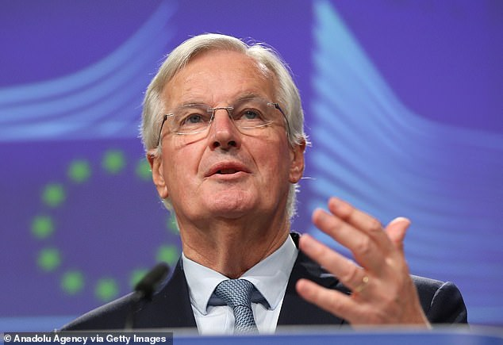
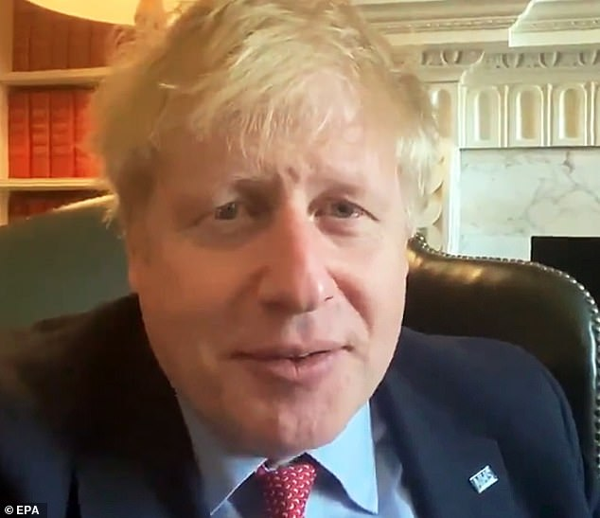
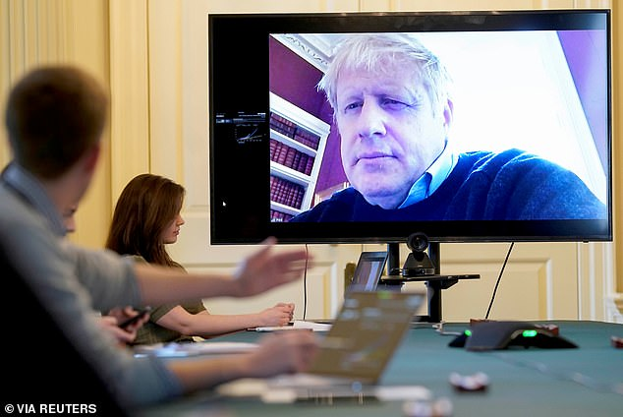
ANALYSE THE ARTICLE: THE PHOTOS
Aides and advisers gathered in the Cabinet room for a series of video conferences with Mr Johnson, including the morning ‘Covid-19 war committee’, where the latest NHS data and international comparisons are shared
The coronavrius that has laid Boris Johnson low may have passed into Westminster’s inner circle via the EU’s chief Brexit negotiator Michel Barnier, according to one theory
Sources say that although Mr Johnson is trying to maintain his ‘usual sunny self’, he is blighted by a dry cough. He is continuing to fulfil his duties, speaking on Friday evening to Donald Trump

Slide 7
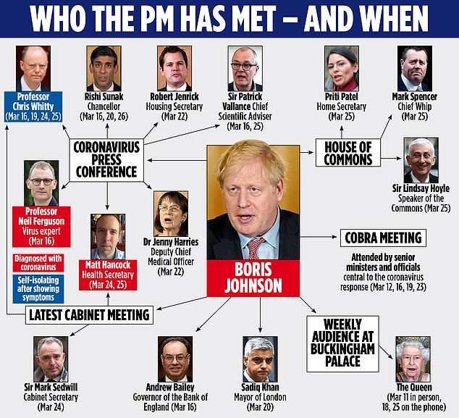
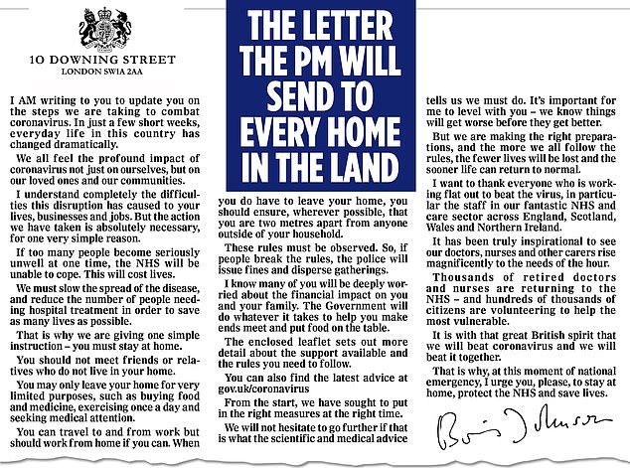
ANALYSE THE ARTICLE: THE ILLUSTRATIONS

Slide 8
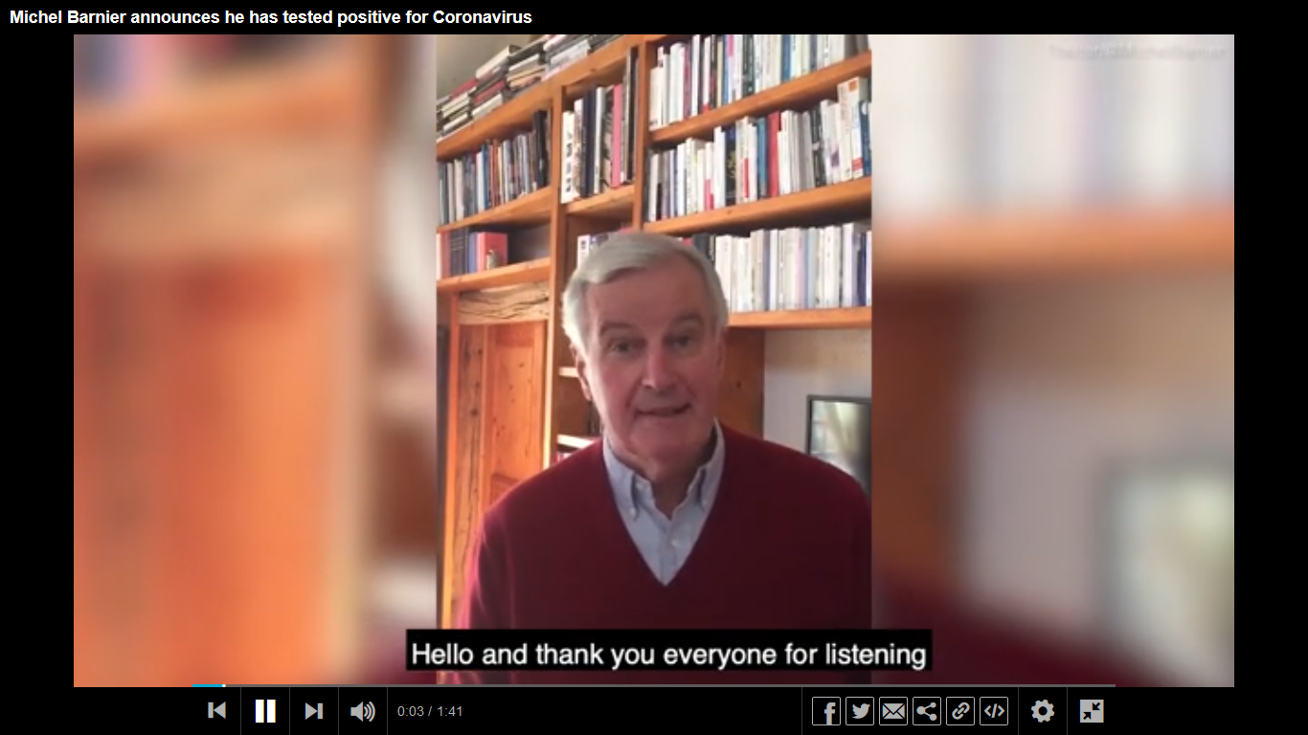
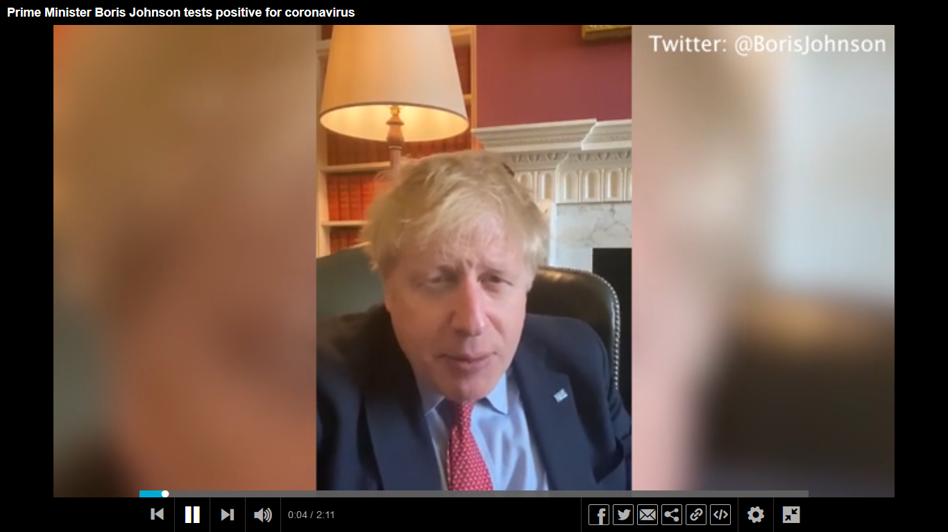
ANALYSE THE ARTICLE: THE VIDEOS

Slide 9
EU VS UK
The coronavrius that has laid Boris Johnson low may have passed into Westminster’s inner circle via the EU’s chief Brexit negotiator Michel Barnier, according to one theory
Sources say that although Mr Johnson is trying to maintain his ‘usual sunny self’, he is blighted by a dry cough. He is continuing to fulfil his duties, speaking on Friday evening to Donald Trump

Slide 10
COMPARE
 | MICHEL BARNIER | BORIS JOHNSON
Which insitution does he represent?
What words are associated with him?
What adjectives are associated with him?

Slide 11
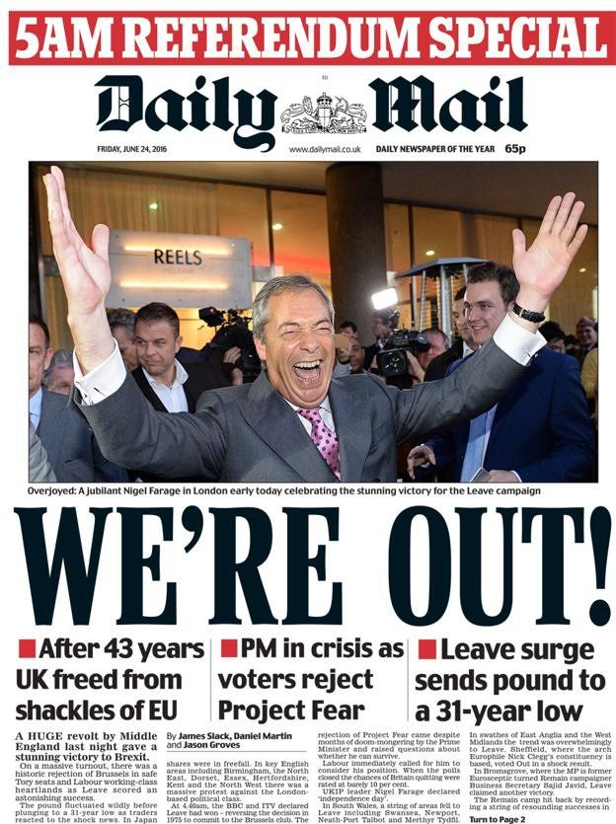
ANALYSE THE ARTICLE: A PRO-BREXIT ARTICLE
What does the Daily Mail think about “Brexit”? Why can we say that the previous article is influenced by this opinion?
24 June 2019

Slide 12
LA REACTION EUROPEENNE DANS LA PRESSE FRANÇAISE
Le Monde, samedi 4 avril 2020

Slide 13
SITES DE FACT-CHECKING EN FRANÇAIS
Plateforme collaborative de lutte contre la désinformation
Service de fact-checking de France Info
Service de fact-checking du Monde
Site de l’ancien émission de décodage Arrêt sur image
Service de fact-checking de Libération

Slide 14
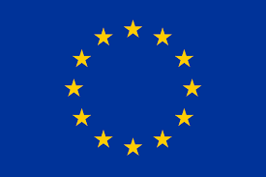
CHECK THE FACTS
The EUvsDisinfo database has been accumulating coronavirus-related disinformation cases for more than two months.
19 European media outlets from 13 countries are fact-checking the May 2019 European elections.

Slide 15
CHECK THE FACTS
« Reality check »:
Fact-checking website of the BBC.
«BBBC Teach »:
A collection of resources from around the BBC to help students spot fake news and false information
Full Fact is a charity based in London to check and correct facts reported in the news.
The global news agency has created a new fact-checking unit within its editorial department. The principle aim of this unit is to fact check visual material and claims posted on social media. The fact checking producers in this unit report their findings on a specially-created blog.
Fact-checks by Channel 4 News journalists.
Notes:
https://www.channel4.com/news/factcheck/
Reuters is a global news agency

Slide 16
CHECK THE FACTS
This nonpartisan, nonprofit project of the Annenberg Public Policy Center of the University of Pennsylvania monitors the factual accuracy of what is said by U.S. political players, including politicians, TV ads, debates, interviews and news releases.
While not a fact-checking site, AllSides curates stories from right, center and left-leaning media so that readers can easily compare how bias influences reporting on each topic.
This Pulitzer Prize winning website rates the accuracy of claims by elected officials. Run by editors and reporters from the independent newspaper Tampa Bay Times, Politicfact features the Truth-O-Meter that rates statements as “True,” “Mostly True,” “Half True,” “False,” and “Pants on Fire.”
This independent, nonpartisan website run by professional researcher and writer David Mikkelson researches urban legends and other rumors. It is often the first to set the facts straight on wild fake news claims.

Slide 17
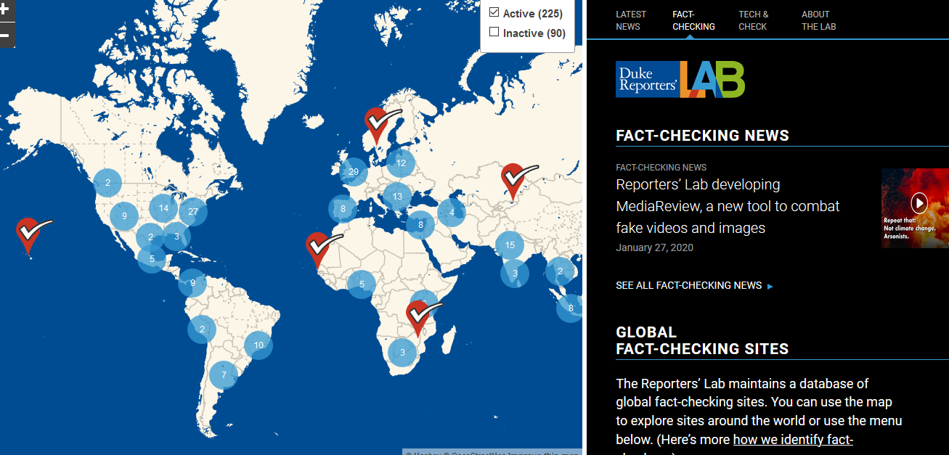
CHECK THE FACTS
The Reporters’ Lab is a center for journalism research in the Sanford School of Public Policy at Duke University. The core projects focus on fact-checking, but they also do occasional research about trust in the news media and other topics.

Slide 18
Outils
Le fact-checking : au service de la démocratie ? (Fiche pédagogique, parue dans le dossier de la Semaine de la presse 2017) sur le site du CLEMI
« Analysing front pages » sur le site la « clé des langues »

